Slide 1
Alien civilization
By: Victoria Tran

Slide 2
Planetary evolution
The Host Star and about the Planet

Slide 3
Host Star [Code Name: Aohi]
Designation – Pleiades
Distance from Earth in Light Years – estimated 136.2 ± 5 pc (2018). Around 427.9 – 460.5 light years.
Size – 4 or 5 solar masses.
Type of Star – A blue star, A or B- type
“Pleiades.” Wikipedia, Wikimedia Foundation, 30 Apr. 2020, en.wikipedia.org/wiki/Pleiades.

Slide 4
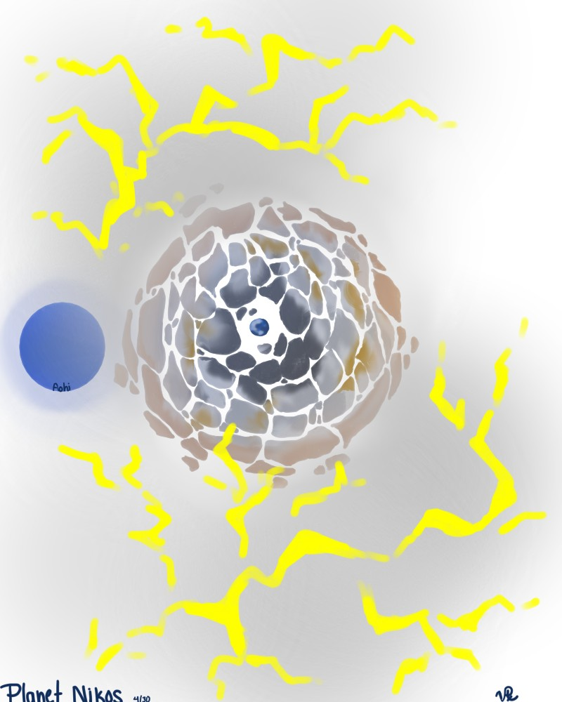
Planet Nikos
Designation – same area as the host star.
Distance from Host Star – Within the habitable zone of the star (a little closer than comfortable), around 50,000,000 miles (8.51 x 10-7) light years away.
Orbital Period – Similar to that of Earth’s, but longer. A year on this planet is close to 500 Earth days. (Host star wobbles more than the Sun)
Size – 422.15 mi.
Strength of Gravity – Weaker than Earth’s the inhabitants can “float”.

Slide 5
Planet Nikos cont.
Atmospheric Composition and Temperature – Instead of an atmosphere, this planet has more of a gel-like fog surrounding it (nicknamed the “Gelosphere”). It is very thick and dense with clouds of electrons and ozone particles (you can almost see the crackles of electricity. Also feels like running through thick gel or something of that sort because of how thick it is). The temperature is hotter than Earth’s due to the hot, blue star that this planet orbits.
If there is Liquid/Composition – This planet has almost no liquid. There is only liquid water at the core of the planet.

Slide 6
Chemical Evolution
Formation of Planet Nikos

Slide 7
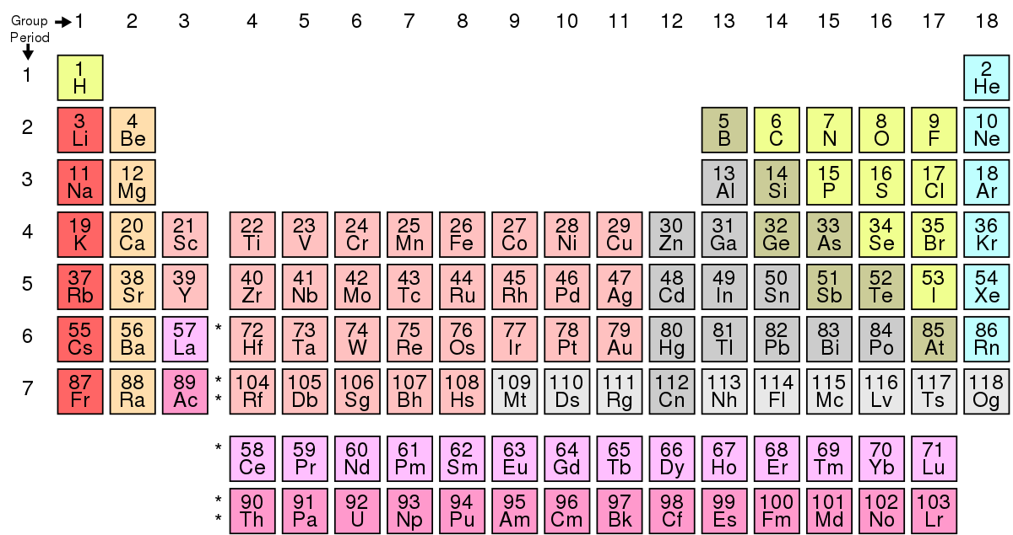
Formation of Planet Nikos
At the beginning of this planet’s evolution, it started like Earth. The host star’s gravity brought asteroids and other rocks floating in space together. Comets with liquid water crashed and brough trace amounts of liquid water, oxygen, and acids to the planet – though it is still metal-based.
The original elements present thus far are hydrogen, helium (from empty space), iron, copper, and other transition metals (from asteroids and other rocks floating by), water, acid, and oxygen (comets).
“Periodic Table.” Wikipedia, Wikimedia Foundation, 4 May 2020, en.wikipedia.org/wiki/Periodic_table.

Slide 8
Formation of Planet Nikos cont.
Thanks to the host star’s plentiful UV rays, these rays broke apart the chemical bonds between elements currently on the forming planet and caused a lot of electrons to detach from their previous arrangements.
The electrostatic force overpowered the strong nuclear force – which would have caused the planet to implode thanks to the power of $E={mc}^{2}…$luckily it did not escalate that fast. The rays caused the electrons to energize the oxygen atoms and from ozone (I do not know if this works…) inside the planet! (This is because the planet is bigger than the actual star and the gravity is not as tight as with Earth. The planet is porous and has empty space in-between rocks. Ozone was able to form inside the planet)
Because of the ozone and thick electron barrier (which is re-energized as the rays keep coming), the Gelosphere protects the planet from too many UV rays.

Slide 9
Formation of Planet Nikos cont.
The heavy rocks that the planet consists of stick together (as the gravity increases due to the Gelosphere tightening around the planet). There are, however, many tunnels of pure ozone and oxygen – like tunnels of air – that go through the planet (which sounds fun). Water congeals at the core, where it is not as hot, and stays there (why not idk what to do).
The planet is finally formed, looking like broken pieces of rock and foggy (that is why it has not been discovered yet). All that’s left is for life to form.

Slide 10
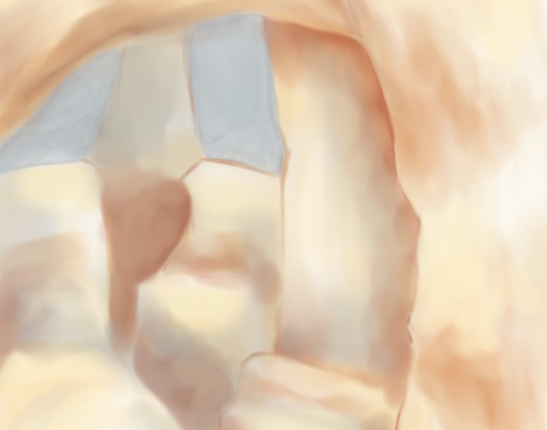
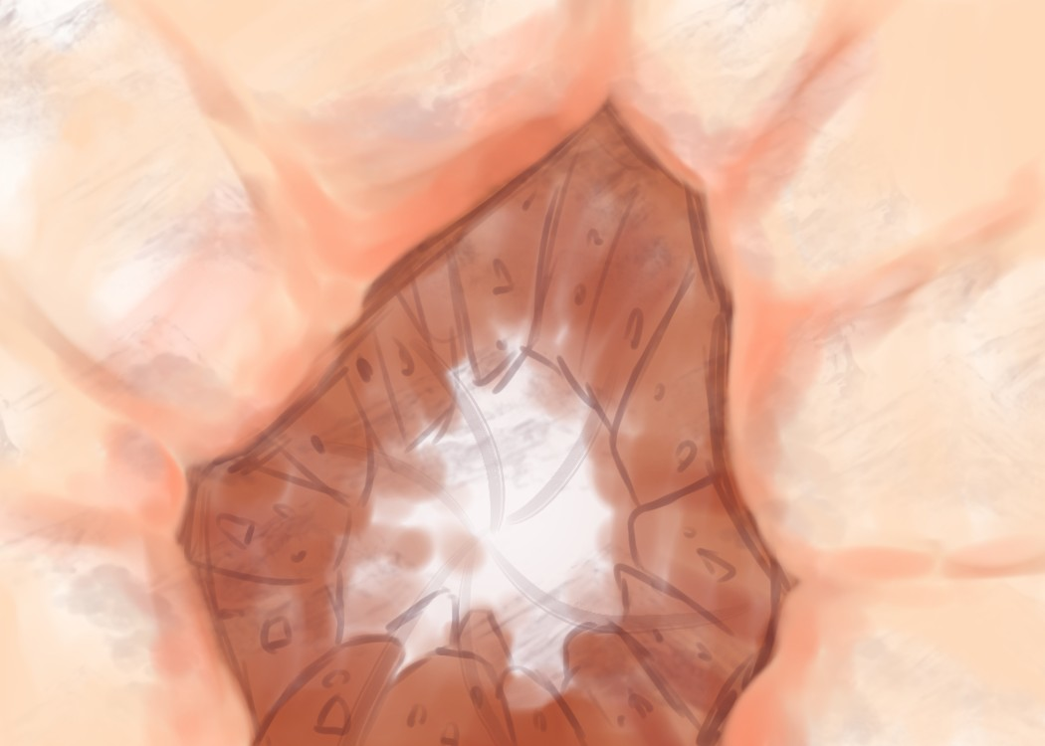
Geography
The geography of the planet is very beautiful – despite its harsh conditions. There are flat deserts, sheer ravines, tall mountains, sand waterfalls, and other rocky formations.
The ozone gas tunnels that separate chunks of rock have fast-moving gas that can sweep away anyone who comes near (or a fast transport system). Life will have to adapt to either live in the air (where it is very hot and lightning prone), or tunnel through the planet’s rocks (using the gas tunnels are a bonus).
None can live in the watery center, as how life on Earth began, as it is too small to sustain life (only about the size of Mercury).
Now let’s see how the first lifeforms come to be.

Slide 11
Biological evolution
How Life Forms

Slide 12
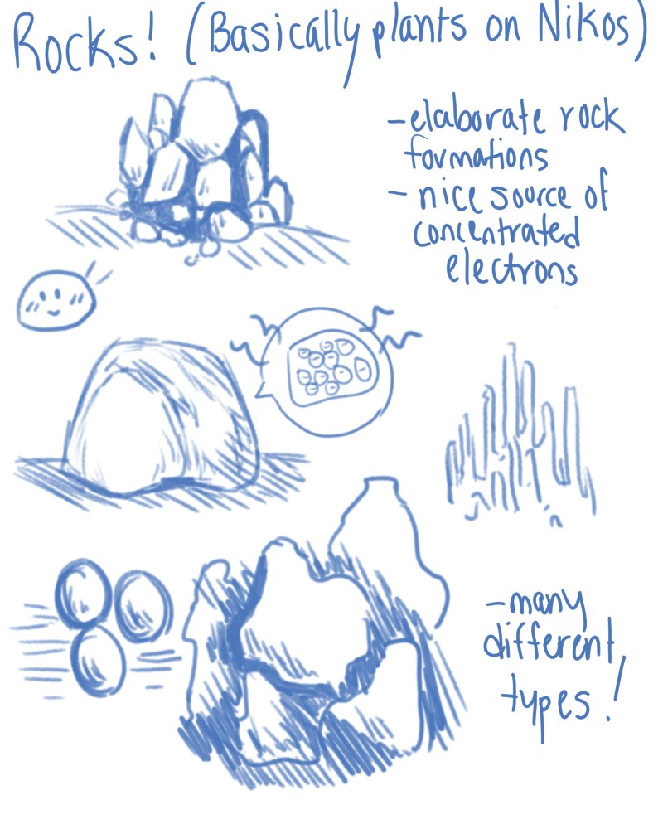
The First “Plants”
On Earth, there are trace amounts of pure magnets – natural elements that are found and magnetized. You probably know what magnets are, those little things that stick on your refrigerator.
Lodestone is a natural magnet that can attract iron, a magnetized piece of the mineral magnetite. It may be rare on Earth, but it is the heart of evolution on this planet.
The first lifeforms started out as little lumps of rock – pebbles even. They absorbed UV rays as energy and cycled electrons to sustain themselves – like proteins on Earth. Their bodies contained conductor metals and magnets like lodestone to create a generator-like system.
The first lifeforms were born! Literally rocks. They act just like plants on Earth. (They take in UV rays and some electrons and give off ozone.

Slide 13
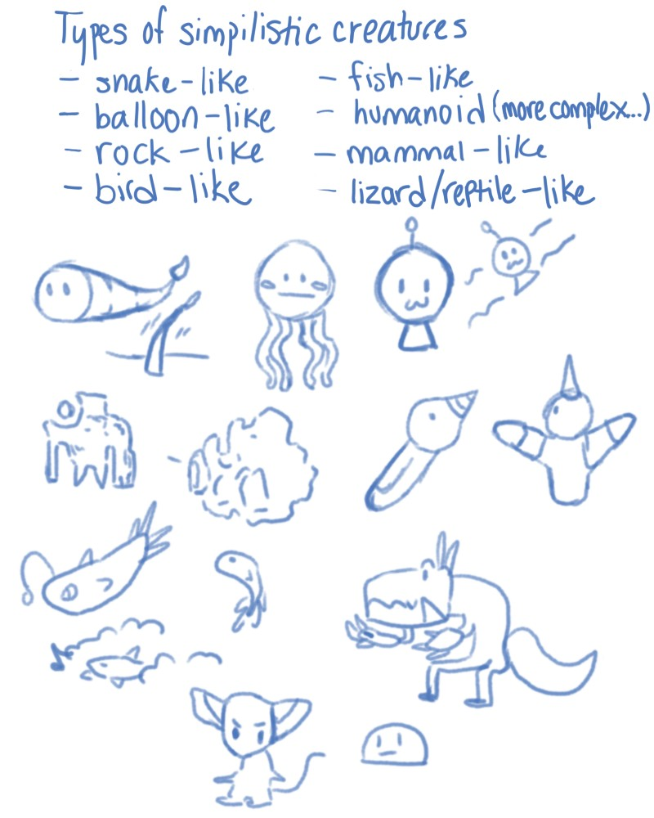
First Diverse Lifeforms
Diverse life formed similarly to life on Earth – through natural selection. The small rocks adapted and evolved into creatures like birds, four-legged mammals, and snake-like reptiles.
Slowly life started to evolve – the light gravity and hot temperatures were a couple of the stimuli. The animals (for lack of a better term) can jump high and across the floating rocks – as well as navigate through tunnels of gas.
Almost all the creatures are rugged in shape and charged with electricity (so do not touch them) They are mostly cold-blooded, as the temperature on this planet rarely changes, and when it does it is not very drastic, so it stays hot every day.
All creatures have magnets or parts of magnets inside them. They can attract and repel metals and even control their bodies (ex: the minerals that are inside their bodies, the electrons they can absorb, etc.)
How will humans fare when added to the mix?

Slide 14
Cultural evolution
Humanoid-like creatures and the Evolution of Life

Slide 15
Types of Life
The main source of energy is UV radiation and electron charges.
There is a food chain. Plant life on this planet is the equivalent of a generator – they take in energy in two different ways and cycle this energy.
Carnivorous life on the other hand, they eat other creatures for their magnetic properties and electrons, as they cannot intake electrons themselves but can regulate them once inside their systems.
The ecosystem is heavily based on electricity in the air as well as the heat of radiation to survive.
There are no viruses or germs of any kind (too hot for them to form), but there are lifeforms that rely on leeching off other creatures.

Slide 16
*Traits not shown

Slide 17
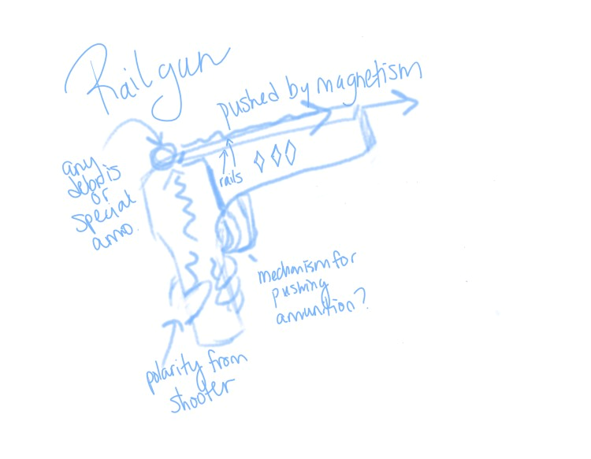
Culture
Electricity is taken for granted and some creatures can harness the electricity as a weapon. For example, a railgun is a device, typically designed as a weapon, that uses electromagnetic force to launch high velocity projectiles. This weapon can be honed down – thanks to the different environment on Nikos – to a small handgun with explosive capabilities.
All creatures treasure the warmth of their planet, as there is no cold ever. The only cold area is in the core of water (which no one goes because they rust if they set foot inside).
Blue is a celebrated color, as the host star is naturally blue in color. All lifeforms recognize this color and associate it with peace and warmth.

Slide 18
Humans
The humans on this planet don’t evolve from primates, instead, they evolve from preexisting creatures. For example, there are humans with tails instead of legs or floating pieces of rock. Humans eat other creatures for their electrons/electrical charge and give off oxygen. They have metal skin in the shape of scales and a polarity aura.
The humans evolve similarly to humans on Earth. They begin like Native Americans. They hunt and eat in packs, are territorial, and focus on survival. They also believe that the strongest should lead – strength is the equivalent to power.
When their minds start to change and they get smarter, they could turn the planet into a technological civilization. Humans used their polarity abilities to connect pieces of rocks to form cities. Electricity and metals can be used to create computers/technology. They focus on trading more than currency and strength in rulers. Their planet revolves around fighting. If you want something you have to fight for it. (Also jewelry is special – the more jewelry, the more important that person is)
Humans also created tools like railguns to aid them – hence why they have arms in the first place (thanks natural selection).
They also have different cultural sports like wind tunnel diving and digging – thanks to the geography of the planet makes them fun to watch and compete (the wind tunnels are also dangerous because many animals make their homes there to eat animals that fly by. A fun and dangerous sport indeed).

Slide 20
Works Cited:
“Pleiades.” Wikipedia, Wikimedia Foundation, 30 Apr. 2020, en.wikipedia.org/wiki/Pleiades.
Hurlbut, Cornelius Searle. “Dana's Minerals and How to Study Them. : Cornelius Searle Hurlbut : Free Download, Borrow, and Streaming.” Internet Archive, Wiley, 1 Jan. 1997, archive.org/details/danasmineralshow00hurl/page/107.
“Blue Dwarf (Red-Dwarf Stage).” Wikipedia, Wikimedia Foundation, 14 Apr. 2020, en.wikipedia.org/wiki/Blue_dwarf_(red-dwarf_stage).
“Lodestone.” Wikipedia, Wikimedia Foundation, 17 Mar. 2020, en.wikipedia.org/wiki/Lodestone.
“Periodic Table.” Wikipedia, Wikimedia Foundation, 4 May 2020, en.wikipedia.org/wiki/Periodic_table.
“Railgun.” Wikipedia, Wikimedia Foundation, 27 Apr. 2020, en.wikipedia.org/wiki/Railgun.
“Rock-Forming Minerals.” Google Books, Google, books.google.com/books?id=2GLGx6A0d0UC&pg=PA403&dq=lodestone#v=onepage&q=lodestone&f=false.
“Star Classification.” Star Classification - Zoom Astronomy, www.enchantedlearning.com/subjects/astronomy/stars/startypes.shtml.

