Slide 1
Welcome to 7th Grade
Mrs. Heath
Math

Slide 2
Take care of your needs. . .
Use hand signals for:
Restroom:
Get permission
Emergency Only
Locker:
Get permission
Emergency Only
ALL issues interrupting class will not be granted unless it’s an emergency situation.
Take care of business BEFORE class.

Slide 3
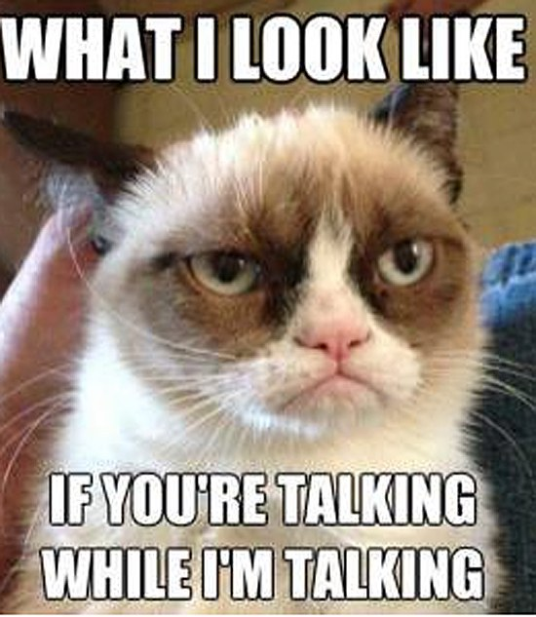
I need your attention. . .
LISTEN for the “clap pattern” . .
You REPEAT the pattern and listen for a 2nd, if needed.
FACE ME
HANDS FREE
MOUTH CLOSED

Slide 4
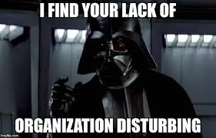
First things. . .
Enter the room SILENTLY
FIND a seat QUICKLY.
Supplies:
Pencil Bag
Math Journal
Math Binder
SHELVE your binder & other items (Any jackets MUST be worn in class or in your locker)
WORK on your “Bell Work” SILENTLY on YOUR OWN. (You will be given 5 minutes – work diligently!)

Slide 5
End of class. . .
PACK UP the room QUICKLY
You are NOT dismissed until I say so. (I won’t dismiss until you have picked up the room)

Slide 6
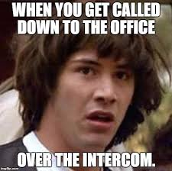
Odds & ends. . .
Phones will be confiscated & turned into the office for a parent to pickup.
LEAVE them in your LOCKER, turned OFF.
Room INTERCOM: Silence in the room . … I am the only one who speaks to the intercom.

Slide 7
work. . .
Neat, legible work is required
WORK must be shown or the paper will not be accepted – at that point, it is LATE and will have points deducted.
ALL PAPERS must have 4 things:
FIRST NAME, LAST NAME
Class COLOR
Class Period #
Date
NO NAME papers will be Placed in a bin, sorted by class period, for YOU to find. I don’t chase you around . . .

Slide 8
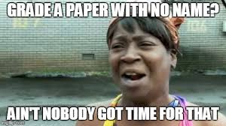
Turning in. . .
ALL WORK is turned in at the back in the proper box.
LATE/ABSENT work is turned in to the proper box – different than daily work/homework
LATE WORK:
-10 points for each day it is late.
Missing work MUST be turned in by the Friday BEFORE each Break to be accepted.
Each student receives 250 points at the start of each Quarter. Late points are deducted from there.
Your actual mastery grade will be put in the system for that paper.

Slide 9
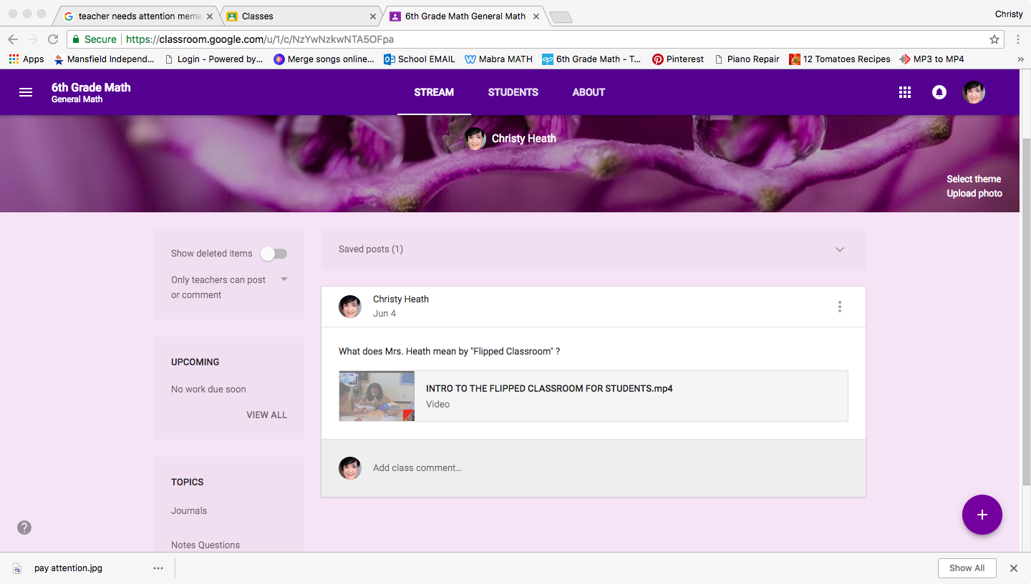
COPIES of WORK. . .
MATH WEBSITE
Google Classroom, Too!
YOU CAN FIND:
Homework assignments
Class assignments
Notes
VideoNotes
Important Messages
I DO NOT keep extra copies of work in the classroom.

Slide 10
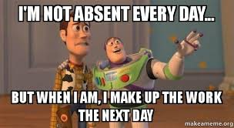
If you are absent. . .
On your FIRST DAY BACK:
Check the Absent Wall for work on the days you missed.
Bring those papers to ME for due dates.
WATCH the videos from those lessons & take NOTES into your math journal.
TURN papers in ON TIME, or late points will be deducted.
If you don’t understand and need HELP, make sure to sign up for TUTORING. (sheet outside my door)

Slide 11
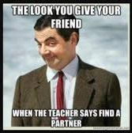
LOTS of PARTNER WORK. . .
DISCUSS Math ONLY
Work TOGETHER and HELP (NOT give answers)
Hold each other accountable
Take the work SERIOUSLY – it WILL show in your grades if you are not.
REFER to your journal notes if you are stuck.

Slide 12
Grades. . .
ASK your parents to SHOW YOU how to check YOUR OWN grades.
Stay on top of them – check them every day.
If you have a ZERO, check the no-name board first. . . Then download the assignment from the website & get it turned in.
Get it turned in FAST – points are being deducted!

Slide 13
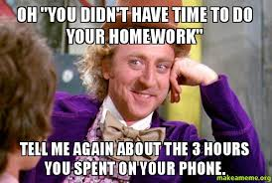
Homework. . .
3 types of HW:
1) Lesson Notes – AT HOME (graded the following day)
2) WEEKLY Skills HW paper. Passed out on Friday, due the following Friday.
3) DAILY homework based on skills covered in class. (Might skip days here & there)
HW is posted on Google Classroom OR the Math Website, should you need an extra copy.

Slide 14
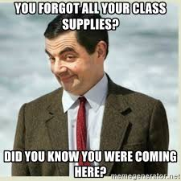
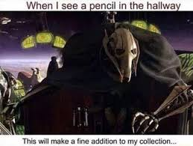
Responsibility. . .
Come to class PREPARED with all supplies.
No pencil? 1) BORROW one from the Supply Manager
MY TABLE: Always bring a dry-erase marker (should be in your pencil pouch) and your Journal.
If you RUN OUT of supplies, it is YOUR JOB to notify your parents to get you more.

Slide 15
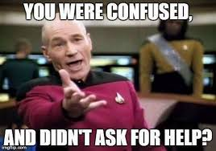
NEED HELP ?
Name – and what you are stuck on WRITTEN on a STICKY NOTE – SILENTLY place it on my table. I will answer as soon as I can. ASK another student for help if needed.
SIGN up for TUTORING. The sheet is on the outside of my door. It is YOUR JOB to ask for help and sign up.

Slide 16
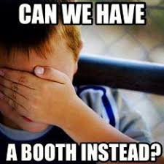
Seating . . .
FIRST COME FIRST SERVE…
WALK – DO NOT RUSH….
Choose where YOU will work your best. (and STAY ON TASK)
I have the right to remove you from your seat at anytime – without discussion. (we may discuss AFTER class…)
Treat the seating choices WITH RESPECT – don’t rock, bounce, play around.
If you can’t handle it, I’m sure I can find you somewhere else to sit.

Slide 17
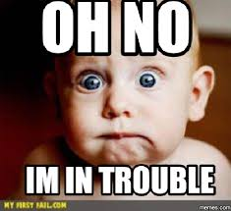
Zones. . .
WORK HARD together ……
Class Helpers distribute supplies needed & collect them when finished.
I will call SWITCH when it is time . . . Pack up your activity & turn it in at the zone area. Pick up your next scheduled activity.
When we SWITCH, we do so in ABSOLUTE SILENCE. Consequence = Signing.
You will visit TWO zones per day.

Slide 18
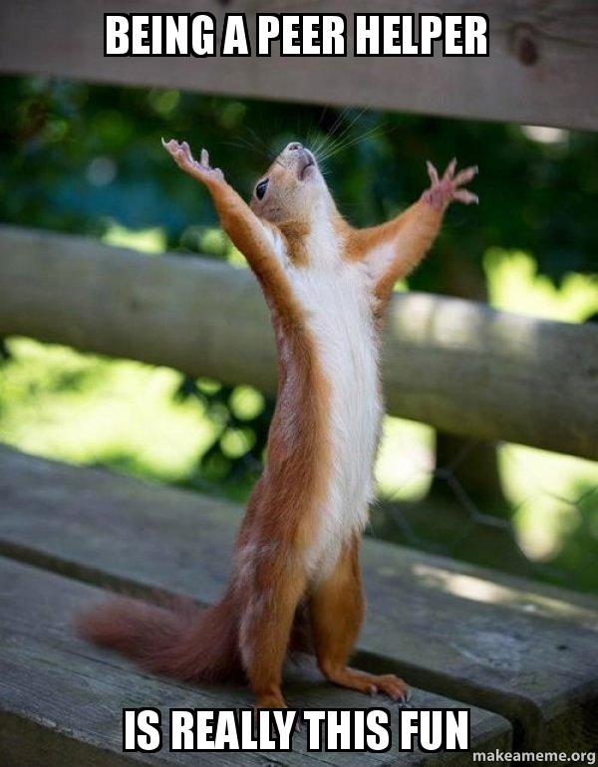
JOBS . . .
Teacher’s Assistant:
Arrange library, help keep it organized
Run Errands for me
Help with various duties
Absent Buddy: Responsible for creating a folder for the absent student
Supply Managers: Arrange for borrowed supplies & their return - notify me of anything running out
Zone Organizer: Checks the Zone boxes when switching to another rotation & makes sure things are packed up properly with no missing parts.
Time Keeper: Sets a timer to keep us on track for bell work, rotation switches & packing up
Paper Passers: Responsible for passing out papers to students in their “assigned area.”
Custodian’s Helper: Supervises students picking up trash, cleaning the area at the end of class.

Slide 19
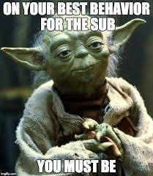
Substitutes. . .
AUTOMATIC after-school DETENTION if you make it on “the list” for giving problems to a substitute.
Specific helpers will be listed for the substitute
They are also my in-class witnesses to behaviors with the substitute.
I expect AMAZING reports from the substitutes VISITING our room – I expect you to treat him/her with respect and do exactly as the substitute says (regardless of what I might normally do).

Slide 20
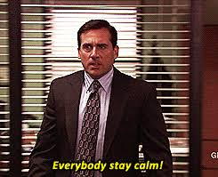
Emergency Drills. . .
FOLLOW DIRECTIONS
Move QUICKLY but within CONTROL.
SILENT AT ALL TIMES
(REGARDLESS of what anyone else may be doing. . . )
Emergency drills are there to TRAIN us for EMERGENCIES like fire, tornado, or lock down situations. These situations are SERIOUS, and we need to train correctly for them or we won’t know what to do when the time REALLY comes.

