Slide 1
Composite Figures

Slide 2
Warm Up
1. What is the area of a rectangle with length 10 cm and width 4 cm?
2. What is the area of a circle with diameter 18 ft?
3. What is the area of a triangle with base 16 cm and height 8 cm?
40 cm²
254 ft²
64 cm²

Slide 3
Composite Figures
A composite figure is formed from two or more figures.
To find the area of a composite figure:
Find the areas of each figure then add them up.
To find the area of a shaded region, you need to subtract the areas.

Slide 4
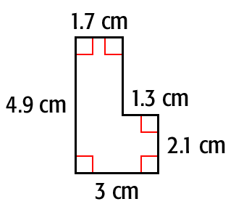


Additional Example 1A: Finding Areas of Composite Figures
Find the area of the polygon.
1.7 cm
1.3 cm
4.9 cm
2.1 cm
Think: Break the polygon apart into rectangles.
Find the area of each rectangle.

Slide 5
Additional Example 1A Continued
1.7 cm
1.3 cm
4.9 cm
2.1 cm
A = lw
A = lw
Write the formula for the area of a rectangle.
A = 4.9 • 1.7
A = 2.1 • 1.3
A = 8.33
A = 2.73
8.33 + 2.73 = 11.06
Add to find the total area.
The area of the polygon is 11.06 cm².

Slide 6
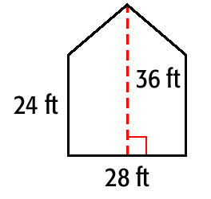
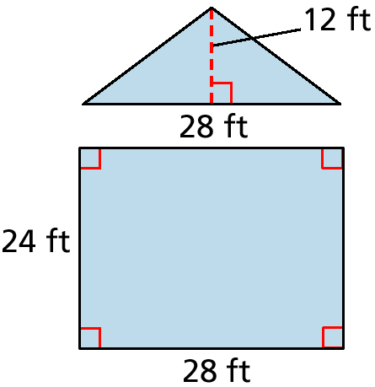
Additional Example 1B: Finding Areas of Composite Figures
Find the area of the polygon.
Think: Break the figure apart into a rectangle and a triangle.
Find the area of each polygon.

Slide 7
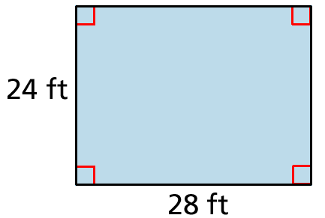
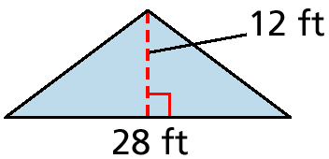
Additional Example 1B Continued
1
__
A = bh
2
A = lw
1
__
A = • 28 • 12
A = 28 • 24
2
A = 168
A = 672
672 + 168 = 840
Add to find the total area of the polygon.
The area of the polygon is 840 ft².

Slide 8
Example #1: Find the area of the composite figure.
The composite figure contains 2 triangles and 1 square. We need to find the area of each region.
Area of 1 triangle:
A = ½ bh
A = ½ (7)(4)
A = ½ (28)
A = 14 yds²
Area of square:
A = lw = 7(7) = 49 yd²
Total area of figure: Add up areas of 2 triangles and square:
A = 2(14) + 49
= 28 + 49 = 77 yd².

Slide 9
Example #2: Find the area of the figure.
The figure contains:
1 square and a semicircle
Area of square:
A = lw = 6(6) = 36 ft²
Area of circle:
A = πr²
A = π(3)² = 9π ft²
Area of semicircle =
½ (9π) = 4.5π ft²
3 ft.
Total area of figure:
Add areas of square and semicircle:
A = 36 + 4.5π ft²
=50.1 ft²

Slide 10
Example #3: Find the area of the shaded region if the area of the square is 64 ft².
We are given the area of the square, we need to find the area of the circle.
What is its radius?
Diameter = Length of square = = 8 ft.
Radius = ½ (8) = 4 ft.
Area of circle:
A = πr²
A = π(4)² = 16π ft².
d = 8 ft.
Area of shaded region =
Area of square – Area of circle
A = 64 - 16π ft².
=13.7 ft²

Slide 11
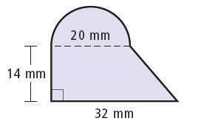

Example 1A: Finding the Areas of Composite Figures by Adding
Find the shaded area. Round to the nearest tenth, if necessary.
Divide the figure into parts.
area of half circle:

Slide 12

Example 1A Continued
area of triangle:
area of the rectangle:
A = bh = 20(14) = 280 mm²
shaded area:
50π + 280 + 84 ≈ 521.1 mm²

Slide 13
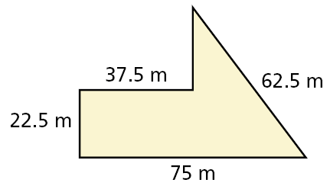

Check It Out! Example 1
Find the shaded area. Round to the nearest tenth, if necessary.
Area of rectangle:
A = bh = 37.5(22.5)
= 843.75 m²
Area of triangle:
Total shaded area is about 1781.3 m².
= 937.5 m²

Slide 14
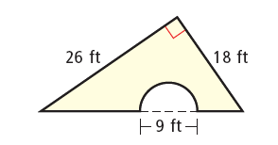


Example 2: Finding the Areas of Composite Figures by Subtracting
Find the shaded area. Round to the nearest tenth, if necessary.
area of a triangle:
area of the half circle:
Subtract the area of the half circle from the area of the triangle.
area of figure:
234 – 10.125π ≈ 202.2 ft²

Slide 15
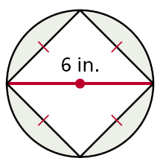
Check It Out! Example 2
Find the shaded area. Round to the nearest tenth, if necessary.
area of circle:
A = πr² = π(3)² ≈ 28.3 in²
area of square:
A = bh ≈ (4.24)(4.24) ≈ 18 in²
area of figure: 28.3 – 18 = 10.3 in²

Slide 16
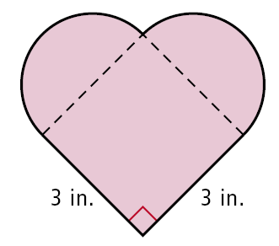
Example 3: Fabric Application
A company receives an order for 65 pieces of fabric in the given shape. Each piece is to be dyed red. To dye 6 in² of fabric, 2 oz of dye is needed. How much dye is needed for the entire order?
To find the area of the shape in square inches, divide the shape into parts.
The two half circles have the same area as one circle.

Slide 17

Example 3 Continued
The area of the circle is
π(1.5)² = 2.25π in².
The area of the square is
(3)² = 9 in².
The total area of the shape is 2.25π + 9 ≈ 16.1 in².
The total area of the 65 pieces is 65(16.1) ≈ 1044.5 in².
The company will need 1044.5 ≈ 348 oz of dye for the entire order.

Slide 18
QUIZ
Show your work!
1. Find the area of the entire figure below.
20 cm
2. Find the area of the shaded region above.

