Slide 1
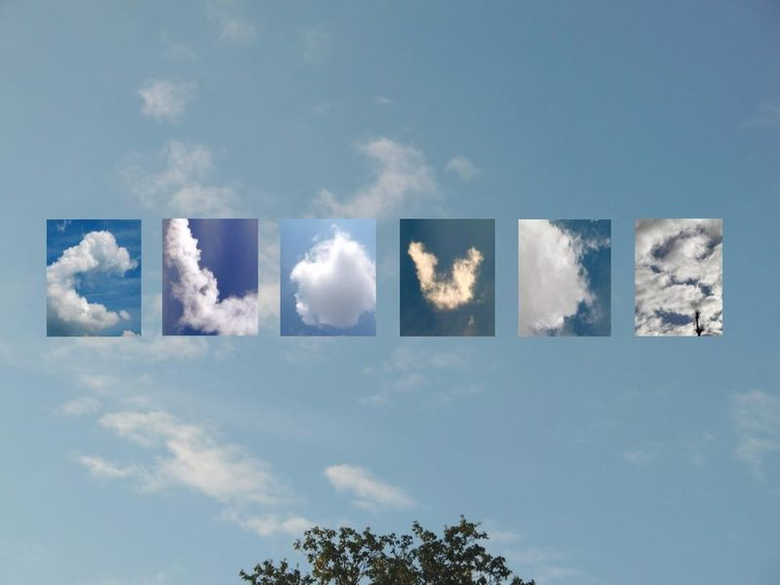
Clouds

Slide 2
How do clouds form?
When water vapor in the air becomes liquid water or ice crystals.

Slide 3
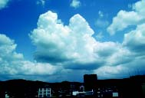
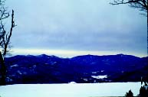
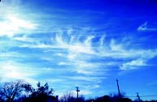
Cloud Shape
The 3 main cloud shapes are:
Cirrus
(Wispy)
Cumulus
(Puffy)
Stratus
(Layered)
Altitude and shape are keys to identifying clouds.

Slide 4
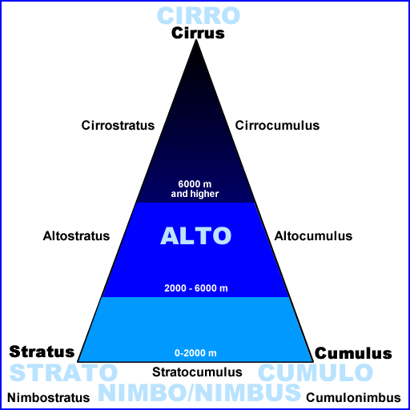
The Cloud Triangle
Clouds can be defined by:
Their shape & form
The cloud base altitude
If they are precipitating
Notes:
The first indicator for determining cloud type is the general shape and form of the cloud (see next slide).
Next, the altitude at which the base of the cloud rests determines whether it is a low (no prefix), middle (alto- prefix), or high (cirro- prefix) altitude cloud.
If the cloud is precipitating (rain, snow, or hail) then it is considered either a Nimbostratus or Cumulonimbus cloud, depending on its form. The precipitation doesn’t necessarily have to reach the ground (i.e., it evaporates before hitting the ground surface).
The next several slides provide images of these major cloud types.

Slide 5
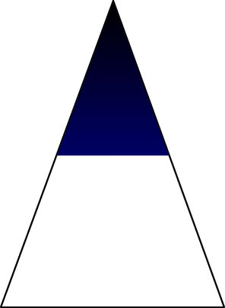
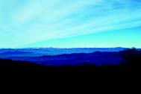
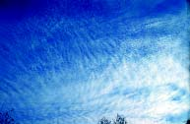
High-level clouds
Cirrus
Cirrostratus
Cirrocumulus
Notes:
High clouds are located at 6000m and higher in mid-latitudes.
Cirrus
delicate filaments
hair-like appearance
Cirrostratus
halos often indicate presence
Cirrocumulus
Cirrocumulus clouds are thin white layers that look like patches of cotton or ripples.

Slide 6
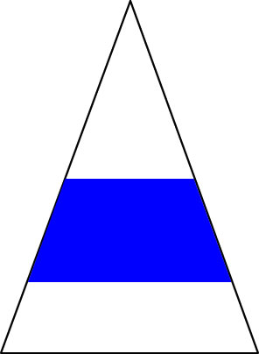
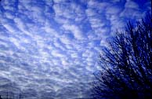
Middle Clouds Alto is the prefix for mid-level clouds.
Mid-level clouds
Altostratus
Altocumulus
Notes:
Alto is the prefix for mid-level clouds.
Altocumulus
Form in sheets of “cloudlets” or “elements” that look like waves on the sea, tiny cumulus, balls of cotton, or even little castle towers.
A good rule of thumb to use to help determine if a cloud is altocumulus is if the individual puffs are wider than one finger, but not as wide as two fingers, when your hand is held at arm's length.
Altostratus
uniform gray sheet
sun may be dimly visible
no halo

Slide 7
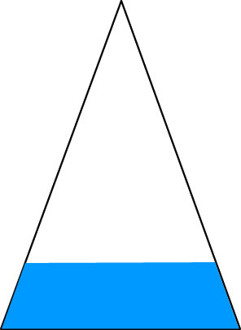
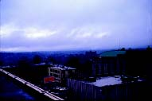
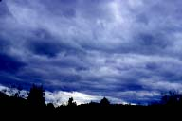
Low-level clouds
Stratus
Cumulus
Stratocumulus
Notes:
Cumulus
Puffy on top, flat bottom
Big cumulus look like cauliflowers
Stratus
Uniform sheets of cloud
Statocumulus
Horizontal sheets of cloud, not as uniform as stratus
Both the tops and bottoms of the elements in these clouds are rounded.
They can look like waves on the ocean, joined flat cumulus, or a continuous but irregular layer.

Slide 8
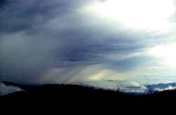
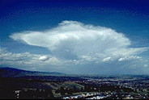
Nimbus means Precipitation
Low-level clouds
Nimbostratus
Cumulonimbus
Notes:
Nimbo or Nimbus refers to the presence of precipitation.
Cumulonimbus clouds can rise to very high altitudes, but their cloud bases occur at low altitude.
The top of a cumulonimbus becomes anvil shaped because its updraft encounters warmer (less dense) air and can’t rise any farther. Instead, the rising air spreads horizontally, creating the anvil.

Slide 9
Estimating Percentages
Cloud Cover
No Clouds 0%
Clear 0 - 10%
Isolated 10 - 25%
Scattered 25 - 50%
Broken 50 - 90%
Overcast >90%
Notes:
Categories based on percentage of cover are used to report cloud and contrail cover.
You may want to have students practice estimating the percentage of coverage by working individually and then comparing their results in small groups.

Slide 10
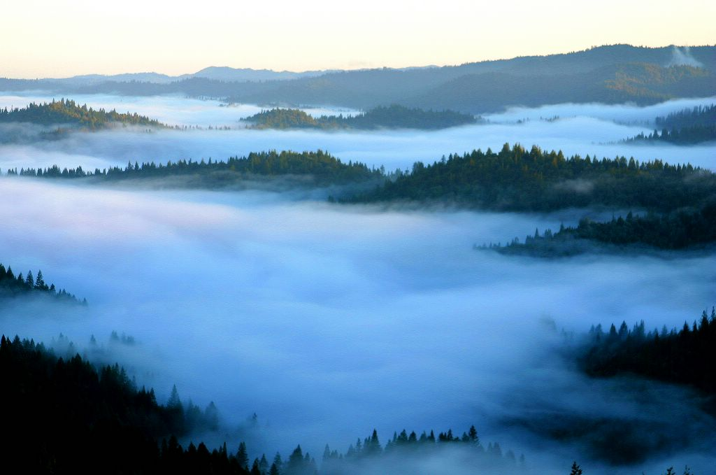
FOG
A cloud in contact with the ground.

