Slide 1

Motivation
Perspectives on Motivation
  Instincts and Evolutionary Psychology
  Drives and Incentives
  Optimum Arousal
  A Hierarchy of Needs/Motivations
Hunger
  The Physiology and Psychology of Hunger
Sexual Motivation
  The Physiology and Psychology of Sex
  Sexuality and Sexual Orientation
  Sex and Human Values
The Need to Belong
Motivation at Work

Slide 2

Motivation
Standard definitions
An internal state that activates and directs behavior
A need or desire that energizes behavior and directs it toward a goal
A condition of arousal that cannot be observed directly, only inferred from behaviors/ actions that ensue

Slide 3
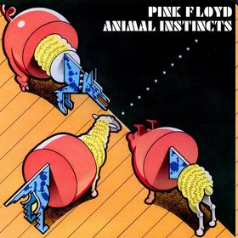
Theories of Motivation
Instinct Theory (oldest)
  Instincts are inborn, inflexible behaviors characteristic of a species (aka fixed action pattern)
    Spiders spin webs and birds fly south
    Can you think of any instincts motivate human behavior?

Slide 4
Theories of Motivation
Drive-Reduction Theory (Hull)
  Biological needs create internal states of tension or arousal – called drives – which organisms are motivated to reduce
  The aim of drive reduction is homeostasis, the need to maintain a steady internal state (e.g., temperature, food)
  Other motivations are extensions of primary drives, a form of generalization (called secondary drives). Examples?
Need
(e.g., for
food, water)
Drive
(hunger, thirst)
Drive-reducing
behaviors
(eating, drinking)

Slide 5
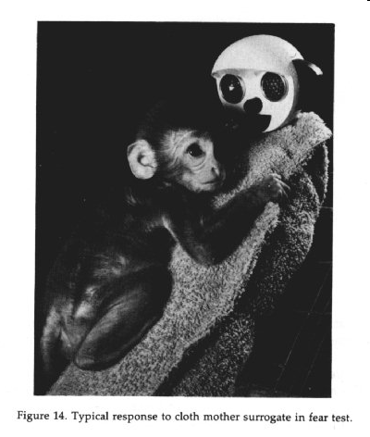
Instinct and Drive Reduction?
How do instinct theory and drive reduction theory fail to explain the full range of human motivation?
Drive-reduction theory was challenged by Harry Harlow’s experiments in contact comfort, exploration and curiosity, and other needs/drives

Slide 6
Theories of Motivation
Arousal Theory
  Humans seek optimum levels of arousal. Levels vary from situation to situation, and from person to person
  Young monkeys and children explore the environment in the absence of need-based drives (exploration, curiosity, manipulation needs)
  Some motivated behaviors actually increase tensions and arousal. Examples?
  Why do we engage in these? Risk-taking behavior may play an adaptive role. Evolutionary Psychology

Slide 7
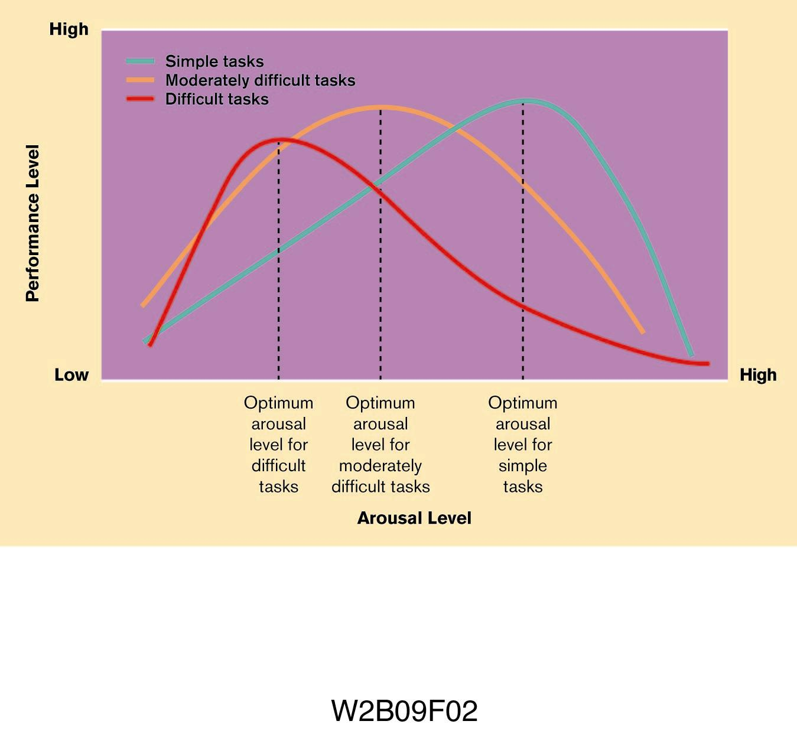
Arousal and Yerkes–Dodson Law

Slide 8

Incentive Theory
Based on Behaviorism (Skinner). We are motivated by what we can get out of a situation
Where our needs push, incentives (positive or negative stimuli) pull us in reducing our drives

Slide 9
Intrinsic and Extrinsic Motivation
Intrinsic motivation
  Activities that are motivated without external rewards that are done for the joy of doing them, e.g.?
Extrinsic motivation
  Activities that are motivated by the pleasant or unpleasant consequences that follow them

Slide 10
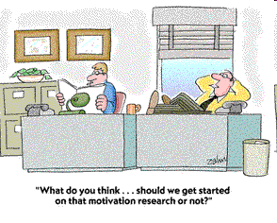
Cognitive Theory
Different than incentive theory in that motivation can be either based on intrinsic or extrinsic factors. We weigh the risks and rewards of a situation and then make a decision

Slide 11
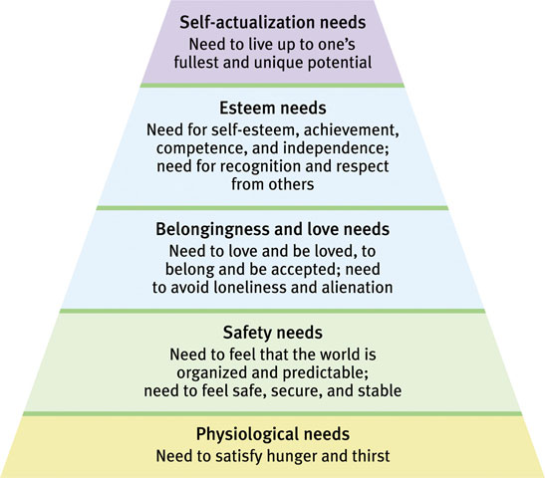
Maslow’s Hierarchy of Needs
Humanist psychologist Abraham Maslow proposed that certain needs have priority over others
Physiological needs come before psychological needs. Lower needs must be minimally met before ascending
Maslow HoN

Slide 12
Maslow’s Hierarchy of Needs
Some Qualities of Self-actualizers
  Accurately perceive reality
  Are comfortable with life
  Accept themselves and others
  Have good humor and tolerance
  Judge honestly and spot quickly the fake and dishonest
  Believe they have a mission to accomplish
  Need to devote their life to some larger good
  Do not depend on external authority or other people
  Are inner-driven, autonomous, and independent
  Feel a strong fellowship with all of humanity
  Have relationships characterized by deep and loving bonds
  Are able to laugh at themselves
  Their sense of humor never involves hostility or criticism
  Frequently have peak experiences that include deep meaning, insight, and harmony with the universe

Slide 13
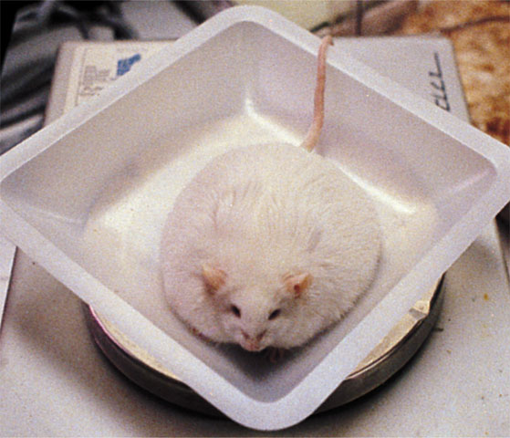
Physiology of Hunger
The central role of the hypothalamus in hunger
The lateral hypothalamus (LH) brings on hunger. In lesioning experiments the LH of rats is destroyed, and rats lose interest in eating. When stimulated?
The ventromedial hypothalamus (VMH) acts as a satiety center and depresses hunger. Destroy the VMH, and the animal eats excessively…When stimulated?

Slide 14
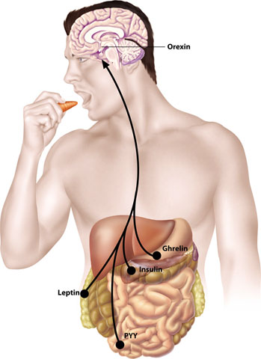
Physiology of Hunger
Hormones implicated in hunger and monitored by the hypothalamus
Hormone | Tissue | Response
Orexin | Hypothalamus (LH) | Increases hunger
Ghrelin | Stomach | Increases hunger
Insulin | Pancreas | Increases hunger
Leptin increase | Fat cells | Decreases hunger
PPY increase | Digestive tract | Decreases hunger

Slide 15
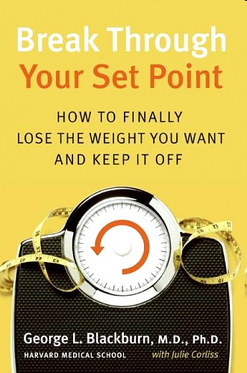
Physiology of Hunger
Basal Metabolic Rate
  Body’s base rate of energy expenditure
Set point theory
  “Weight thermostat”
  When the body falls below this weight, an increase in hunger and a lowered metabolic rate may act to restore the lost weight
Nutrition Data/BMI

Slide 16
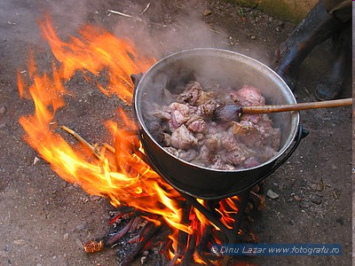

The Psychology of Hunger
Research shows a complex interplay of physiological and psychological processes. Responses to food are governed by learning and social conditioning
  Time of day
  Role of expectations (sham experiments)
  Culture influences (what we eat and how much we consume…)
  While some preferences are biological, most are psychological and cultural (e.g. food exposure, neophobia) ) Disgust
  Eating habits can be influenced by emotion, i.e., depression, boredom, anxiety, anger. . .

Slide 17
Psychology of Eating Disorders
Anorexia Nervosa
  When a normal-weight person diets and becomes significantly (>15%) underweight, yet, still feeling fat, continues to starve self. An aspect to Body Dysmorphic Disorder
  Motive for abnormal thinness overwhelms homeostatic pressures–societal/psychological bases
  Physiological bases (serontonin hypothesis?)
Bulimia Nervosa
  Disorder characterized by episodes of overeating, usually of high-calorie foods, followed by vomiting, laxative use, fasting, or excessive exercise (exercise bulimia)

Slide 18

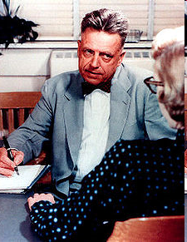
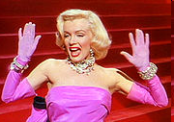
Physiology of Sexual Motivation
Kinsey Report (attitudes) and Masters and Johnson (physiology). Sexual illiteracy
Response Cycle-excitement/plateau/orgasm/resolution
Refractory period
Estrogen and testosterone
Sexual orientation (and theories)

Slide 19
Need for Achievement (NAch)
Achievement Motivation A desire for significant accomplishment or attaining a high standard; for mastery of things, people, or ideas (N-Ach)
David McClelland
Thematic Apperception Test (TAT)

Slide 20
Need for Achievement (NAch)
  People with a high need for achievement (nAch) seek to excel and thus tend to avoid both low-risk and high-risk situations – Weiner Ring Toss
Low need for achievement people
  Are unwilling to take chances to test their skills and abilities
  Motivated more by fear of failure than by hope and expectation of success

Slide 21
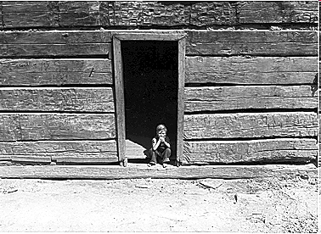
Thematic Apperception Test
A projective personality test introduced by Henry Murray and later refined and used by David McClelland to measure achievement
  What is happening in this picture?
  What is the boy thinking?
  What will he do next?

Slide 22
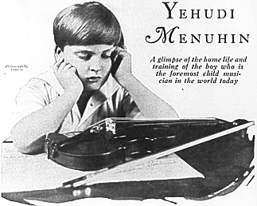
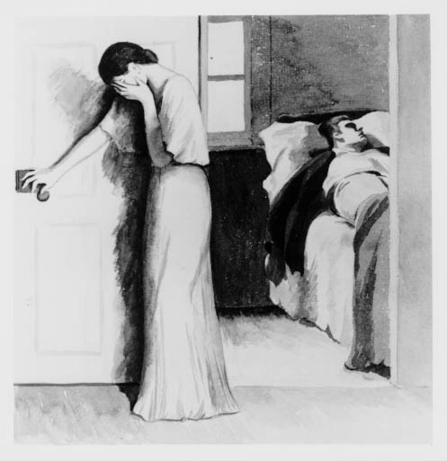
Thematic Apperception Test
Scoring the TAT
1. Does the story contain some
reference to competition with a
standard of excellence?
2. Is one of the characters concerned
with excelling or doing well?
3. Does the story include a unique
accomplishment? Invention?
4. Is there reference to a long-term
goal, e.g. professional?
5. Is strong feeling expressed about
taking action or seeking success?

Slide 23
Need for Affiliation (nAff) and Other Needs
Seeking harmonious relationships and the need to feel accepted by other people. Survival and reproductive benefits of affiliation? (Ev Psychs)
  N-Aff is aroused especially when people feel threatened, under stress, or a need to commiserate or work together
  Role of fear and anxiety. Schachter’s misery loves company experiments (esprit de corps)
Stimulus motives: curiosity, exploration manipulation and contact comfort needs (Harlow)
Aggression – Vestigial “need?” Role of frustration? Learned aggression? Gender? Culture?
Dominance and power. Personal and institutional (social)

Slide 24
Motivation and Work
Industrial/Organizational (I/O) Psychology The application of psychological concepts and methods to optimize human behavior in workplaces
  Organizational Psychology Sub-field of I-O psychology that examines organizational influences on worker satisfaction and productivity and facilitates organizational change
  Personnel Psychology Sub-field of I-O psychology that focuses on employee recruitment, selection, placement, training, appraisal, and development
  Theory X Assumes that workers are basically lazy, error-prone, and extrinsically motivated by money. Workers should be directed from above
  Theory Y Assumes that, given challenge and freedom, workers are motivated to achieve self-esteem and to demonstrate their competence and creativity
  Flow A completely involved, focused state of consciousness, with diminished awareness of self and time, results from optimal engagement of one’s skills Csikzentmihalyi

