Slide 1
Sensation and Perception
Sensation A process by which our sensory receptors and nervous system receive and represent stimulus energy
Perception A process of organizing and interpreting sensory information, enabling us to recognize meaningful objects and events

Slide 2
Basic Principles in Sensation
Psychophysics
Top Down v. Bottom Up Processing
Transduction Physical energy → neural impulses
Absolute Threshold
Difference Threshold=Just Noticeable Difference (JND)
Weber’s Law or Constant
Signal Detection Theory (v. Threshold theory)

Slide 3
Vision
Phototransduction The conversion of one form of light energy to into neural impulses
Light Characteristics
  Wavelength (hue/color)
  Intensity (brightness/amplitude)
  Saturation (purity)

Slide 4
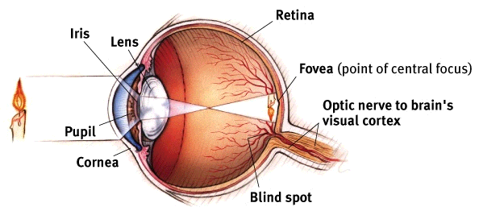
Vision

Slide 5
Vision
Pupil Adjustable opening in the center of the eye
Cornea Transparent tissue where light enters the eye
Iris Ring of muscle that forms the colored portion of the eye. Controls the size of the pupil opening
Lens Changes shape to focus images on the retina (visual accommodation)

Slide 6
Vision
Retina The light-sensitive inner surface of the eye. Contains receptor rods and cones plus layers of neurons that begin the processing of visual information

Slide 7
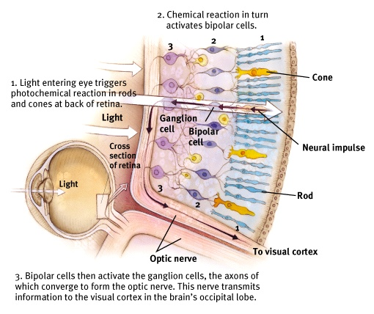

Slide 8
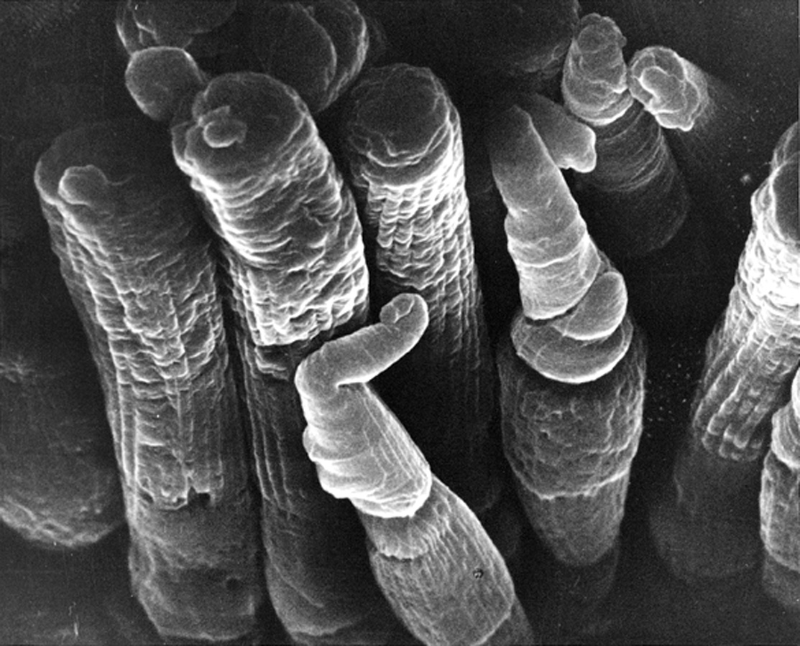
Retinal Reaction to Light (Receptor Cells)
Rods
  Confined to the peripheral retina (120 million)
  Detect black, white and grey. Low light
Cones
  Found near center of retina (8 million)
  Fine detail and color vision
  Found mostly in fovea

Slide 9
Retinal Reaction to Light
Optic nerve Nerve that carries neural impulses from the eye to the brain
Blind Spot Point at which the optic nerve leaves the eye.
Fovea Central point in the retina, around which the eye’s cones cluster

Slide 10
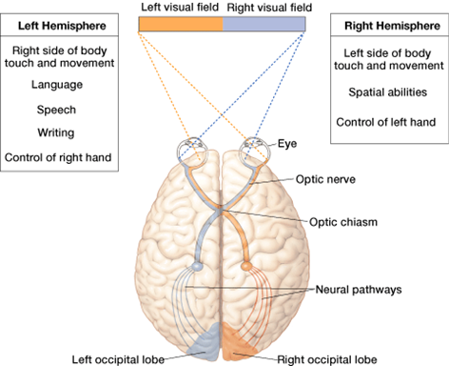
From Eye to Brain
Optic nerve
  Made up of axons of ganglion cells
  Carries neural messages from each eye to brain
Optic chiasm
  Point where part of each optic nerve crosses to the other side of the brain

Slide 11
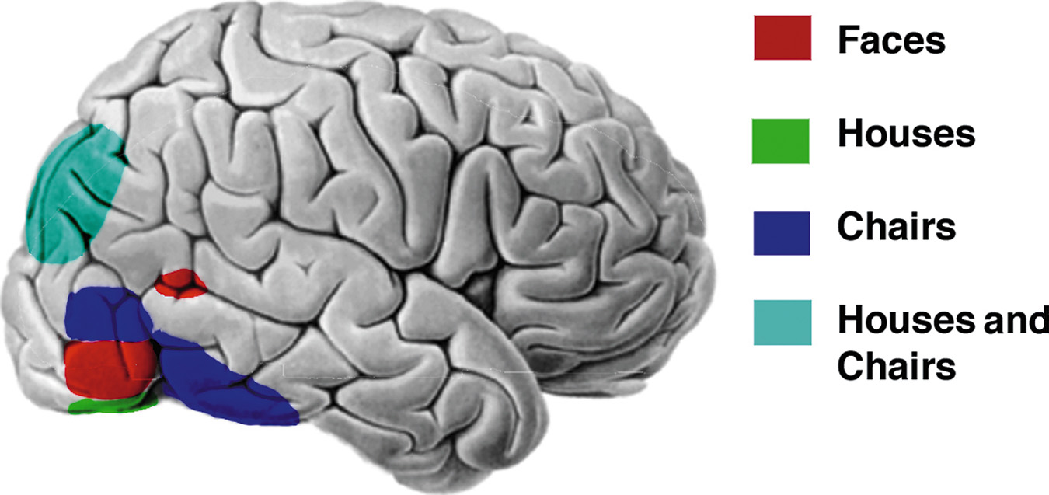
Visual Information Processing
Feature Detector Cells Nerve cells in the brain that respond to specific features, e.g.?

Slide 12
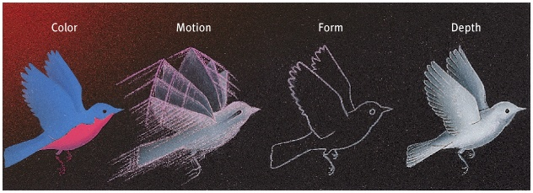
Visual Information Processing
Parallel Processing
  Simultaneous processing of several aspects of a problem simultaneously

Slide 13
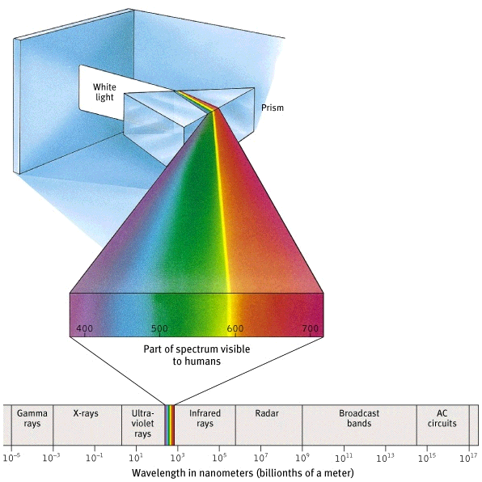
The spectrum of electromagnetic energy

Slide 14
Color Vision in other Species
Other species see colors differently than humans
  Most other mammals are dichromats
  Rodents tend to be monochromats, as are owls who have only rods

Slide 15
Theories of Color Vision
Trichromatic theory (Young-Helmholtz) Suggests that the retina contains three types of color receptors (cones) sensitive to red, blue and green.
  Experience of color is the result of mixing of the signals from these receptors (additive process)
Cannot explain all aspects of color vision

Slide 16
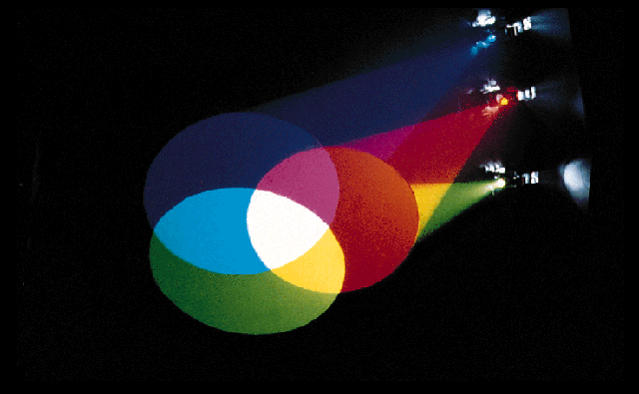
Theories of Color Vision
Additive color mixing
  Mixing of lights of different hues
  Lights, T.V., computer monitors (RGB)
Subtractive color mixing
  Mixing pigments, e.g., paints

Slide 17
Opponent Process Theory
Opponent-process theory Opposing retinal processes (color pairs) enable color vision
  Three pairs of color receptors (On-Off)
    Yellow-blue
    Red-green
    Black-white
  Explains color afterimages
  Both theories of color vision are valid

Slide 18

Afterimage Effect

Slide 19
Afterimage Effect

Slide 20
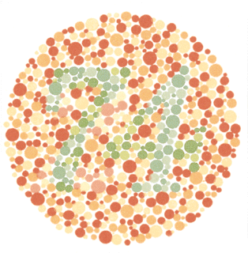
Colorblindness (Color-deficient vision)
Approximately 10% of men and 1% of women have some form of colorblindness
Dichromats and Monochromats

Slide 21
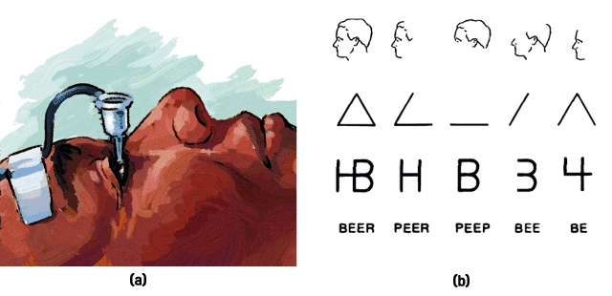
Sensory Adaptation
Dark adaptation (20+ minutes)
Light adaptation (2-3 minutes)
Sensory adaptation – Neuroadaptation

Slide 22


Slide 23
Concepts in Audition (Hearing)
Acoustical transduction Conversion of sound waves into neural impulses in the hair cells of the inner ear.
Characteristics of Sound
  Frequency (pitch)
  Intensity (loudness)
  Quality (timbre)

Slide 24
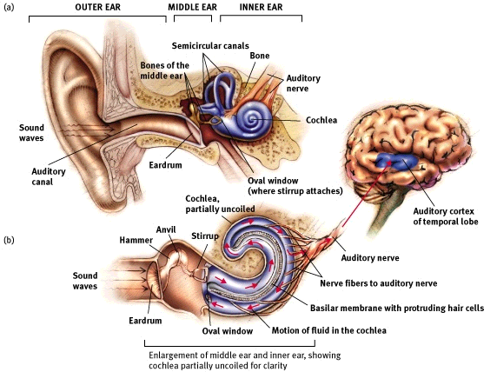

Slide 25
The Ear
Middle Ear
  Chamber between eardrum (tympanic membrane) and cochlea containing three tiny bones (ossicles - hammer, anvil, stirrup) that concentrate the vibrations of the eardrum on the cochlea’s oval window
Inner Ear
  Innermost part of the ear, containing the cochlea, semicircular canals, and vestibular sacs
Cochlea
  Coiled, bony, fluid-filled tube in the inner ear that transforms sound vibrations to auditory signals

Slide 26
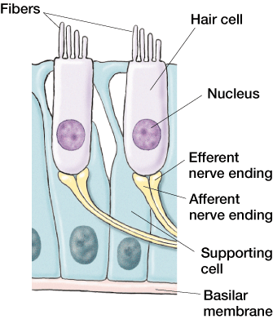
The Ear
Basilar membrane
  Membrane in the cochlea which contains receptor cells
Auditory nerve
  Connection from ear to brain

Slide 27
Theories of Audition
Place Theory suggests that sound frequencies stimulate the basilar membrane at specific places resulting in perceived pitch (explains high pitch)
Frequency Theory states that the rate of nerve impulses traveling up the auditory nerve matches the frequency of a tone, thus enabling us to sense its pitch (low pitch)
Volley Principle The pattern of sequential firing that supports frequency theory

Slide 28
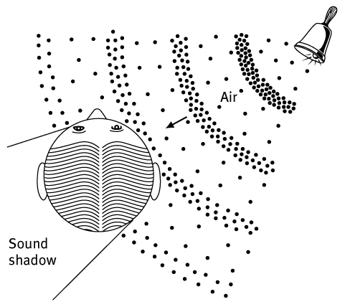
Binaurality and Sound Localization

Slide 29
Hearing Loss
About 30 million people have some form of hearing damage in the U.S.
Conduction Hearing Loss
  Caused by damage to the mechanical system that conducts sound waves to the cochlea
Sensorineural Hearing Loss
  Caused by damage to the cochlea’s receptor cells or to the auditory nerve, also called nerve deafness

Slide 30
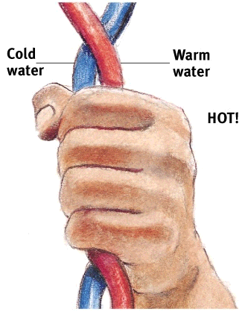
The Skin Senses
Skin Sensations
  pressure
    only skin sensation with identifiable receptors
  warmth
  cold
  pain

Slide 31
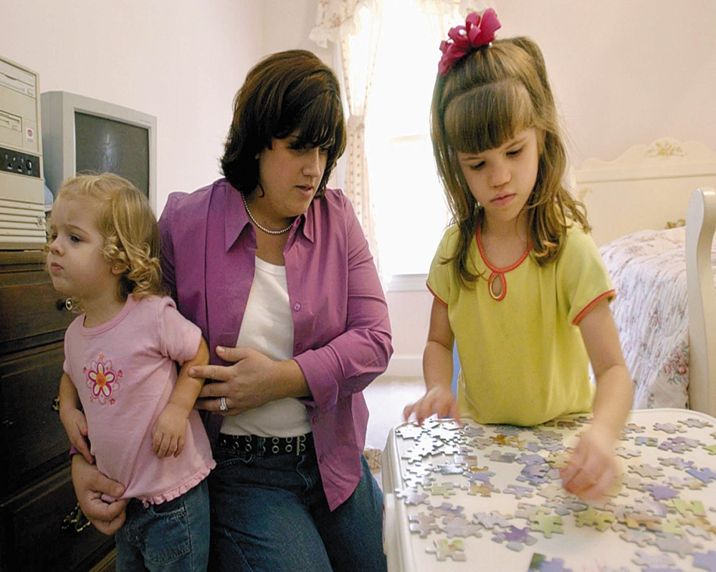
The Skin Senses (Touch Sense-Tactile or Haptic as well)
Skin is the largest sense organ
Pressure, temperature, vibration and pain
Pain tells the body that something has gone wrong

Slide 32
Pain
Gate-Control Theory States that the spinal cord contains a neurological “gate” that blocks pain signals or allows them to pass on to the brain (Melzik and Wall)

Slide 33
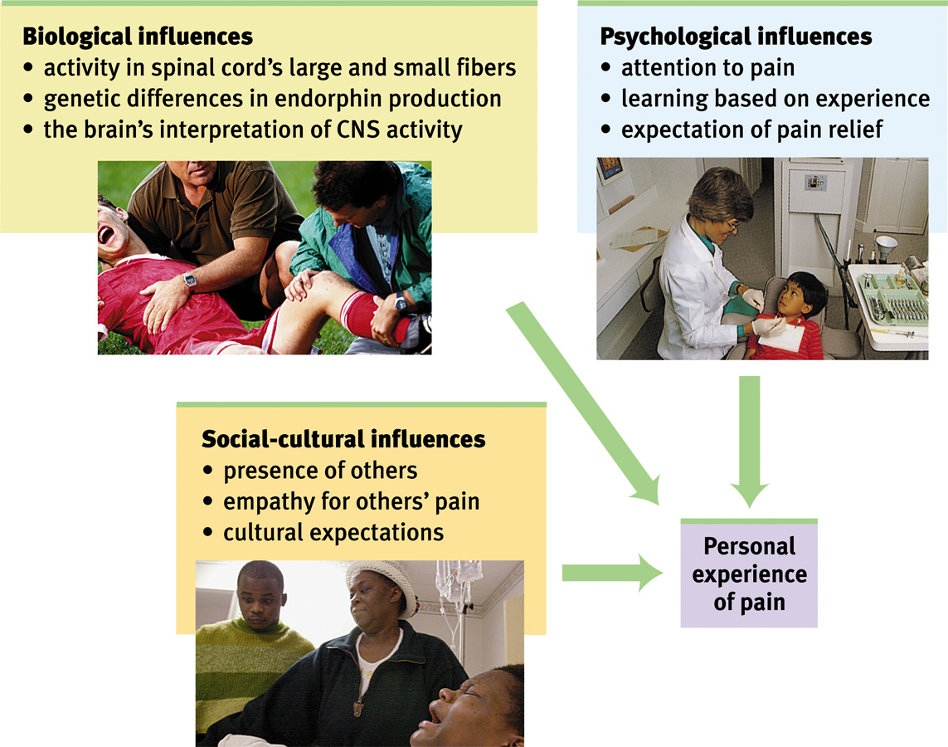
Biopsychosocial Influences and Pain

Slide 34
Sensory Interaction
When one sense affects another sense sensory interaction takes place.
This is especially apparent with the interaction between smell and taste
Visual capture
Cross-adaptation (taste)

Slide 35
Taste
Taste sensations consisted of sweet, salty, sour, and bitter tastes (taste buds). Receptors for a fifth taste have been named called “Umami”
Bitter
Sweet
Salty
Sour
Umami

Slide 36
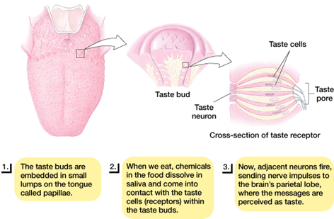
Taste
Receptor cells are located in taste buds
Taste buds are located in papillae on the tongue
Chemicals dissolve in saliva and activate receptors

Slide 37
Olfactory Sense
Detecting common odors
  Odorant binding protein is released and attached to incoming molecules
  These molecules then activate receptors in the olfactory epithelium
  Axons from those receptors project directly to the olfactory bulb

Slide 38
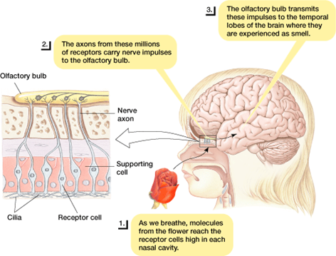
Olfactory Sense
Like taste, smell is a chemical sense
Odorants enter the nasal cavity to stimulate 10+ million receptors to sense smell. Unlike taste, there are many different forms of smell

Slide 39
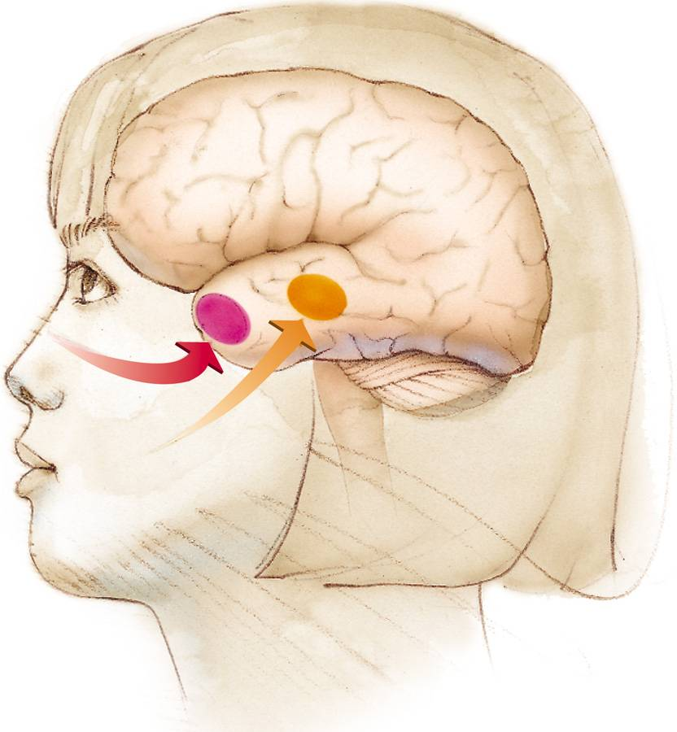
Smell and Memory
The brain region for smell (in red) is closely connected with the brain regions involved with memory (limbic system). That is why strong memories are made through the sense of smell. Smemory

Slide 40
Pheromones and Vomeronasal Organ (VNO)
Pheromones
  Used by animals as a form of communication
  Provides information about sexual receptivity
Pheromones stimulate the vomeronasal organ (VNO)

Slide 41
Body Position and Movement
Kinesthesis Sense that provides information about the speed and direction of movement
  Stretch receptors sense muscle stretch and contraction
  Golgi tendon organs sense movement of tendons
Vestibular Sense Sense that provides information about equilibrium and body position
  Fluid moves in two vestibular sacs
  Vestibular organs are also responsible for motion sickness

