Slide 1
Thinking and Language
Thinking
Concepts
Solving Problems
Making Decisions and Forming Judgments
Belief Bias
Language
Language Structure
Language Development
Thinking & Language
Language Influences Thinking
Thinking in Images
Animal Thinking and Language
Do Animals Exhibit Language?

Slide 2
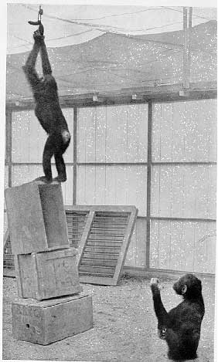
Strategies for Decision Making and Problem Solving
Trial and error
Insight
Algorithm Methodical rule or procedure that assures a solution
Heuristics Simple thinking strategy that often allows us to make judgments and solve problems efficiently
E I S H T S U I C R

Slide 3
Cognitive Errors in Decision Making
Availability Heuristic (or bias) Judging the likelihood of events or objects in terms of availability; how distinct or recently we have heard about the event. Examples?
Representativeness Heuristic Judging the likelihood of things or objects in terms of how well they represent, or match, a particular prototype, e.g.?
What's the Trouble?
Discovering Psychology: Updated Edition 3:00-15:00
Kahneman TED

Slide 4
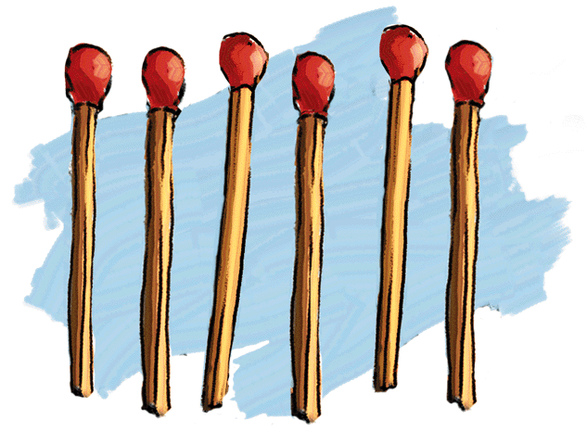
Obstacles to Problem Solving
Mental Set The tendency to approach a problem in a particular way, often in a way that has been suc-cessful in the past. Also known as fixation or set rigidity
Misassumption/ Representation failure
Functional fixedness
The Matchstick Problem Arrange six matches to form four equilateral triangles

Slide 5
Strategies for Overcoming Obstacles
Brainstorming
Problem formulation
Label stripping (for overcoming functional fixedness)
Flexible thinking - divergent v. convergent thought

Slide 6
Language
Language
Our spoken, written, or gestured works and the way we combine them to communicate meaning

Slide 7
Language Structure
Phoneme In a spoken language, the smallest distinctive sound unit
bat, has three phonemes b · a · t
chat, has three phonemes ch · a · t(s)
English 40-46 42 phonemes
Piraha 11/Taa or !Xoo over 100 KhoiSan
Morpheme the smallest unit that carries meaning, e.g.? It may be a word or a part of a word (such as a prefix)
Cat = cat
Prefix = pre· fix
Words Some 300,000 in English (most prolific)
Notes:
OBJECTIVE 11| Describe the basic structural units of language.

Slide 8
Language Acquisition
Infant Sound Discrimination We are all born to recognize (and generate) - Universal adaptability speech sounds from all the world’s languages Resource: The Mind: Teaching Modules
Percentage able
to discriminate
Hindi t’s
100
90
80
70
60
50
40
30
20
10
0
Hindi-
speaking
adults
6-8
months
8-10
months
10-12
months
English-
speaking
adults
Infants from English-speaking homes

Slide 9
Grammar
Grammar is the system of rules in a language that enable us to communicate with and understand others
Grammar
Semantics
Syntax
Semantics Rules by which we derive meaning from words, and sentences. Adding –ed to the word laugh.
Syntax Rules for combining words into grammatically sensible sentences. In English, syntactical rule says that adjectives come before nouns; big house. In Spanish, casa grande

Slide 10
Language Acquisition
Prelinguistic vocalizations to phonemic discrimination…
Babbling Stage Beginning at 3 to 4 months. Infant emulate sounds (phonemes). Universal adaptability. Around ten months babbling resembles home language, other sounds disappear
One-Word Stage (one word utterances-holophrases) From about age 1 through 2 years of age
Two-Word Stage Beginning about age 2. Child speaks in mostly two-word statements (aka telegraphic speech) using mostly nouns and verbs and omitting “auxiliary” words

Slide 11
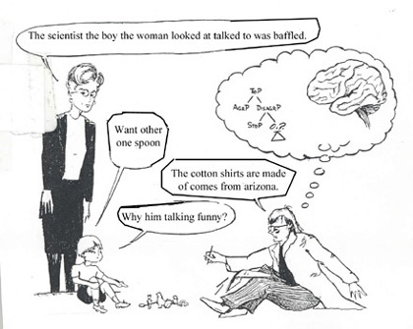
Language Acquisition
Complete sentences 3+ years
Language use is increasingly complex and creative (productive)
Syntax and grammar internalized
Language development is exponential. Children know over 1000 words by age 3
Overregularization occurs. By 5-6 most errors cease
Metalinguistic awareness

Slide 12
Theories of Language Acquisition
Operant Learning (Environmentalists) Skinner believed that language development is explained on the basis of observation and learning principles such as association, imitation, and reinforcement
Nativists led by linguist Noam Chomsky stress a built-in readiness to learn language. He proposes the concept of Language Acquisition Device. Nativists argue that the rate of language acquisition is so rapid that it cannot be explained through learning alone
Universal Grammar
Pinker on Chomsky
Born to Talk

Slide 13
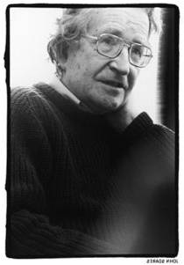
Chomskyan Linguistic Theory
Chomsky differentiates between the surface structure of a language and the deep structure
The boy picked up the book
The boy picked the book up
The book was picked up by the boy
Make me a bologna sandwich!

Slide 14
Chomskyan Linguistic Theory
Unscramble – Ability is uniquely human
Leg the bites the often dog mailman the on.
The at pie is girl table eating some the.
Use in a sentence
Funtageous
Knicknoddled
Ginormous
Twas brillig and the slithy toves did gyre and gimble in the wabe. What were the toves like and what did they do?

Slide 15
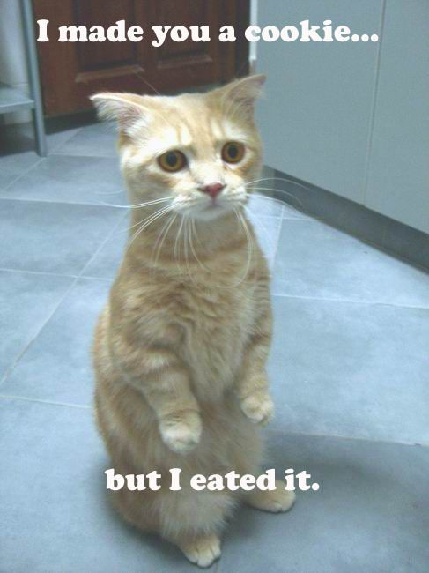
Chomsky and The Nativists’ Evidence
After 24 months language development is exponential. By age 3 children know over 1000 words, by 6 over 14,000 words!
Overregularization errors occur. By 5 most errors cease. Other things Lolcat might say
I runned when I heard a noise
The lizard goed to heaven
Born to Talk

Slide 16
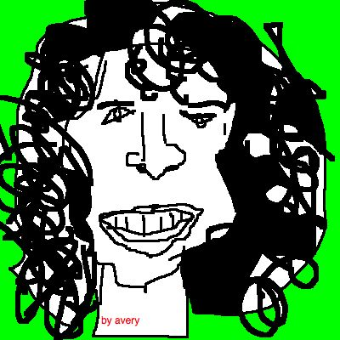
Recent Theories of Language Acquisition
Cognitive neuroscience and statistical learning models (Pinker). Emphasizes the role of both inborn ability (nativist theory) and cognition
Genes design the mechanisms for a language; experience modifies the brain
SciAm Born to Talk and Talking Babies
Social Interactionist Models Interactionists blend reinforcement (environment) and cognition (Vygotsky… McWhinney, Snow) Kuhl McGurk Effect
Language is elicited in a powerful dynamic between caregivers and children. Primary role of parentese

Slide 17
Theories of Language Acquisition
Eric Lenneberg’s Critical period hypothesis supports Nativist theory and the existence of LAD (v. sensitivity period)
The crucial period of language acquisition begins to close at 7 and ends by 12 years. If language is not learned before then, it can never be learned in a fully functional sense
Genie

Slide 18
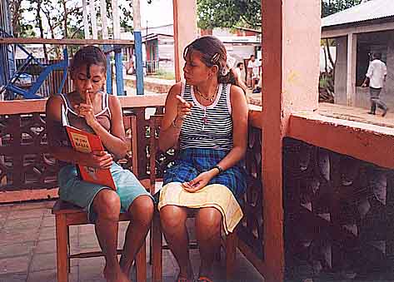
Critical Period and Nicaraguan Sign Language
Recently socialized deaf children in Nicaragua were observed using unfamiliar gestures to communicate with each other. These children developed their own, distinct sign language with rules of "sign-phonology" and syntax
Kegl also discovered 300 adults who had never acquired language, and turned out to be incapable of learning language fully. While it was possible to teach vocabulary, these individuals were unable to learn syntax
Evolution: Library: Birth of a Language

Slide 19
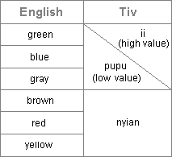
Does Language Determine or Influence Thought?
Sapir-Whorf Linguistic Relativity Hypothesis (aka Linguistic Determinism)
Whorf suggested that language determines the way we think…for example
The Hopi have no past tense for verbs. Some argue they cannot think as readily about the past
The Tiv of Nigeria categorize color based on 3 values. The Piraha of Brazil have no specific words for color and lack number sense. How might this shape their world view?
Notes:
OBJECTIVE 14| Summarize Whorf’s linguistic determinism hypothesis, and comment on its standing in contemporary psychology.

Slide 20
Language Influences Thinking
Current views reject LD as extreme. While language may influence thought, it does not determine it (Lakoff, Levinson, Boroditsky)
As a language provides words for objects or events, we may be able to think about them more clearly and remember them more easily
NPR and China Savings…China Thang
NYT Does Language Shape What You Think?

Slide 21
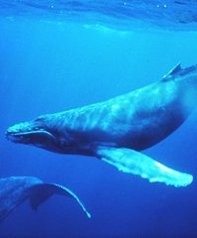
Do Animals Exhibit Language?
All primates, elephants, whales and even honey bees communicate with members of their species
Prairie Dogese
Notes:
OBJECTIVE 17| Outline the arguments for and against the idea that animals and humans share the capacity for language.

Slide 22
Primate Language Studies
Gardner and Gardner (1969) used American Sign Language (ASL) to train Washoe, a chimp, who learned 200+ signs
Bonobo pygmy chimpanzees develop even greater vocabularies and perhaps semantic nuances in learning a language (Savage-Rumbaugh, 1991). Kanzi and Panbanish developed vocabulary for hundreds of words and phrases using lexigrams and CAI
Kanzi and More Kanzi
Great Ape Trust
Koko and Koko Story
The Gorilla Foundation / Koko.org

