Slide 1
Platonic Solids
Regular Polyhedra

Slide 3
Regular Polygons
A regular polygon is a polygon with all sides congruent and all angles congruent such as equilateral triangle, square, regular pentagon, regular hexagon, ………..

Slide 4
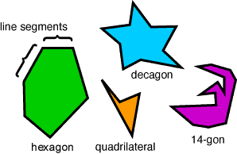
Polygons
Polygons are simple closed plane figures made with three or more line segments.
Polygons cannot be made with any curves.
Polygons are named according to their number of line segments, or sides.

Slide 5
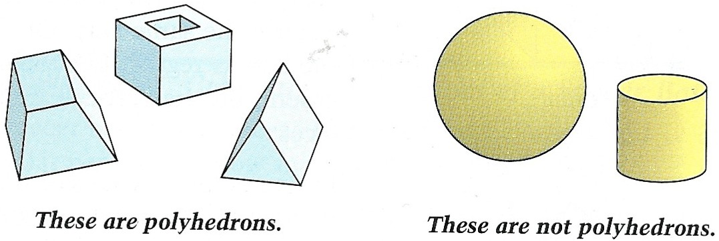
Polyhedron
What is a polyhedron?
Circles are not polygons

Slide 6
Identifying Polyhedra
A polyhedron is a solid that is bounded by polygons, called faces, that enclose a single region of space.
An edge of polyhedron is a line segment formed by the intersection of two faces
A vertex of a polyhedron is a point where three or more edges meet

Slide 7
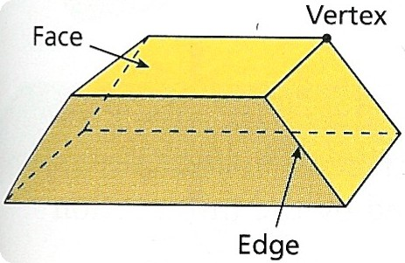
Parts of a Polyhedron

Slide 8
Regular Polyhedra
A polyhedron is regular if all its faces are congruent regular polygons.
Not regular
Vertices are not formed by the same number of faces
3 faces
4 faces
regular

Slide 9
A polyhedron is called a regular polyhedron or Platonic Solids if the faces of the polyhedron are congruent regular polygonal regions, and if each vertex is the intersection of the same number of edges. Polyhedra is the plural for polyhedron. Regular Polyhedra
A polyhedron is called a regular polyhedron or Platonic Solid if the faces of the polyhedron are congruent regular polygonal regions, and if each vertex is the intersection of the same number of edges. Polyhedra is the plural for polyhedron.

Slide 10
Relationship Between Polygons and Polyhedra
A polyhedron and polygon share some of the same qualities. A regular polyhedron’s face is the shape of a regular polygon.
For example: A tetrahedron has a face that is an equilateral triangle. This means that every face that makes the tetrahedron is an equilateral triangle. Around all the vertices and every edge is the same equilateral triangle.

Slide 11
Relationship Between Polygons and Polyhedrons
A polyhedron is made of a net which is basically like a layout plan. It is flat and made of all the faces that you will see on the polyhedron.
For example: A cube has six faces all of them are squares. When you open the cube up and lay it out flat you see all of the six squares that make up the cube.

Slide 12
Platonic Solids
Tetrahedron
Notes:
Euclid proved this in the last proposition of the Elements.

Slide 13
Platonic Solids
Octahedron
Tetrahedron
Notes:
Euclid proved this in the last proposition of the Elements.

Slide 14
Platonic Solids
Octahedron
Tetrahedron
Icosahedron
Notes:
Euclid proved this in the last proposition of the Elements.

Slide 15
Platonic Solids
Cube
Octahedron
Tetrahedron
Icosahedron
Notes:
Euclid proved this in the last proposition of the Elements.

Slide 16
Platonic Solids
~There are only five platonic solids~
Hexahedron
Octahedron
Dodecahedron
Tetrahedron
Icosahedron
Notes:
Euclid proved this in the last proposition of the Elements.

Slide 17
Euler’s Formula and Platonic Solids
,
https://www.youtube.com/watch?v=C36h00d7xGs&list=PLW1zH15TmnByfL1TkOxJW-FuEcFvBH-x_&index=10&t=0s
V - E + F = 2

Slide 18
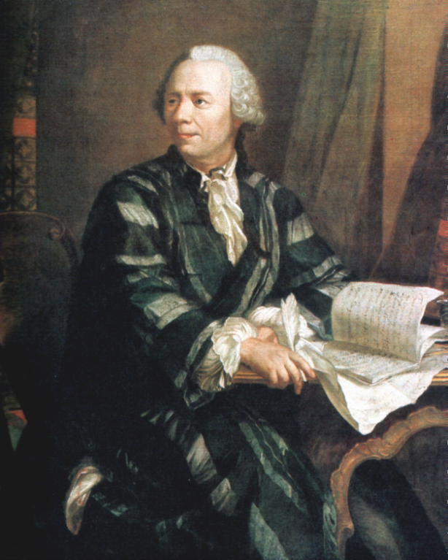
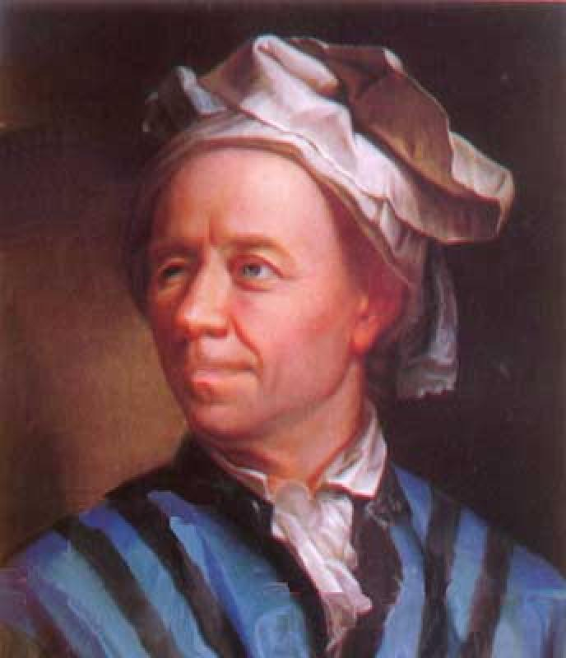
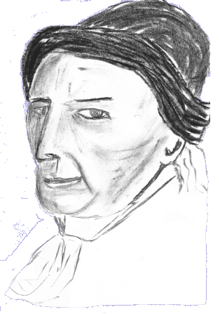
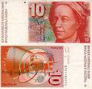
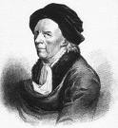
Euler = “Oiler”
Leonhard Euler

